Slide 1

Using Web Workers and Processors to Bend Data to Your Will
Lloyd Heberlie, Matt Priour
Notes:
Learn how to use the newly released Workers & Processors systems to process, modify, aggregate, or analyze your data efficiently. You will learn about these new features of ArcGIS API for JavaScript and see demonstrations of what you can do with them.

Slide 2
Intro to workers
Support
Workers, processors, and ArcGIS API for JavaScript

Slide 3







Intro to Workers
Worker
Notes:
• Worker
• Shared workers

Slide 4
JavaScript and multi-threading
Worker
Worker
Browser
Worker

Slide 5


Feature
Dedicated workers | 3 | 3.5 | 10 | 10.60 | 4 | 5.0 | No | 29 (4.0+)
Shared workers | 3 | No | No | 10.60 | 5 | No | No | No
Blob URI source | Yes | Yes | No | ??? | Yes | Yes | No | Yes
Data URI source | No | Yes | No | ??? | No | No | No | No
Sub Workers | No | Yes | Yes | ??? | No | No | No | No
Structured Cloning | 13 | 8 | 10 typed arrays | 11.50 | 5.1 | ??? | No | ???
Transferable Objects | 21 | 18 | No | 15 | 6 | ??? | No | ???
Static URL methods | 23, 10 as webkitURL | 21 | 11 | 15 | 6 as webKitURL | 6 as webKitURL | No | 29 (4.0+)

Slide 6
Use cases
Prefetching data
Analyzing video / audio
Background I/O of web services
Processing data
Image filtering in <canvas>

Slide 7


Lots of image processing examples
For example …
Full Color to Sepia – 255ms

Slide 8
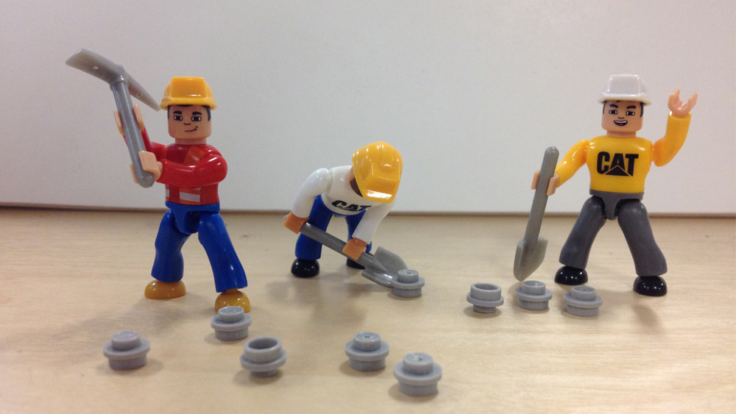

Slide 9

Workers postMessage message – serializable object transfers – transferable object (typed array) onmessage – message event listener event.data

Slide 10
WorkerClient wraps Worker and adds Promises postMessage → Promise importScripts → Promise addWorkerCallback → Promise ‘message’– message event

Slide 11

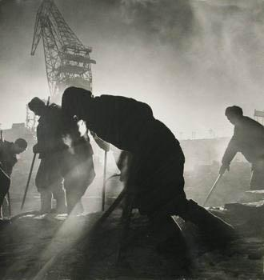

Feature detection
Dojo has
Modernizr

Slide 12
Processors
Spatial Indexing
esri/process/SpatialIndex

Slide 13
Data from
attached layers
Direct or via Layer
Single Layer
Map
All Graphics & Feature Layers
Defined Processor.
Sees all data added to layers.
May intercept.
Sends data to workers (parallel or serial)
Processors
Map or other Display Layer
Stored Results
- index, stats, etc

Slide 14
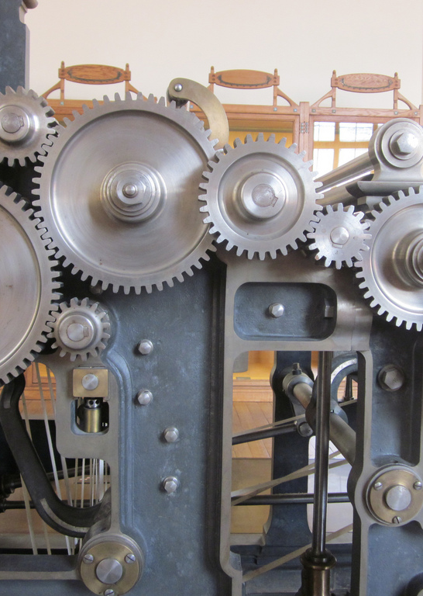
Processor
Base class for processors.
Must implement process functions including what and when to post data to worker.
Options
drawFeatures, passFeatures, workerCallback
Methods
addLayer, removeLayer, setMap, unsetMap, stop

Slide 15
Spatial Index
Easily used by adding Spatial Indexing plugin to your layer or map
plugins:[‘esri/plugins/spatialIndex’]
indexType (‘rtree’ or ‘kdtree’)
Intersects (rtree only)
nearest (kdtree only)
addLayer, removeLayer, setMap, unsetMap, stop

Slide 16

Index & Rendering Demos
Buffer Query
Nearest Point
Known Geometry Binning
Density Surface

Slide 17
Questions?
mpriour@esri.com
@mattpriour

